Slide 1
Advanced CSS
A.F.M. Mahbubur Rahman
Asst. Professor
Dept. of Computer Science & Engineering
Email : m.r.kushal@gmail.com
Contact : 01911064969

Slide 2
Styling Links
Links can be styled with any CSS property (e.g. color, font-family, background, etc.).
Special for links are that they can be styled differently depending on what state they are in.
The four links states are:
a:link - a normal, unvisited link
a:visited - a link the user has visited
a:hover - a link when the user mouses over it
a:active - a link the moment it is clicked
Example

Slide 3
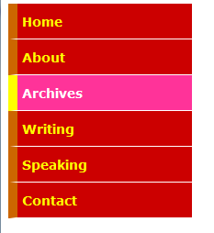
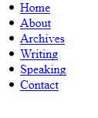
Creating Navigation
Example

Slide 4
CSS Tables
For table, following properties can be adjusted
Table Borders
Collapse Borders
Table Width and Height
Table Text Alignment
Table Padding
Table Color

Slide 5
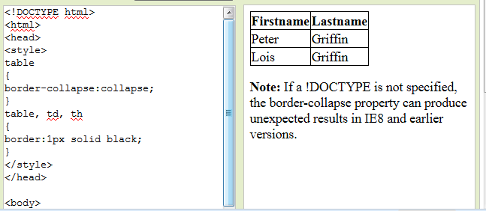
Table Borders
To specify table borders in CSS, we use the border property.
The example below specifies a black border for table, th, and td elements:

Slide 6
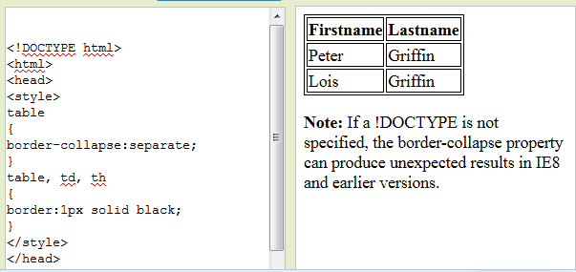
Collapse Borders
The border-collapse property sets whether the table borders are collapsed into a single border or separated:

Slide 7
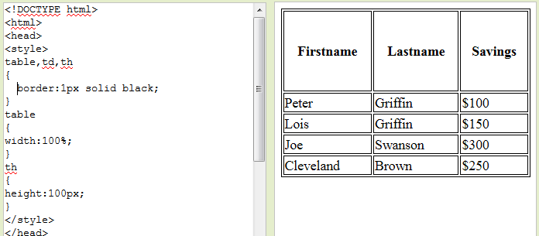
Table Width and Height
Width and height of a table is defined by the width and height properties.

Slide 8
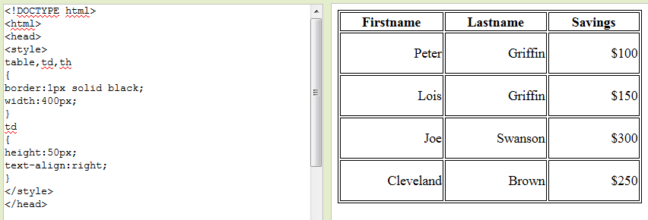
Table Text Alignment
The text in a table is aligned with the
text-align and
vertical-align properties.

Slide 9
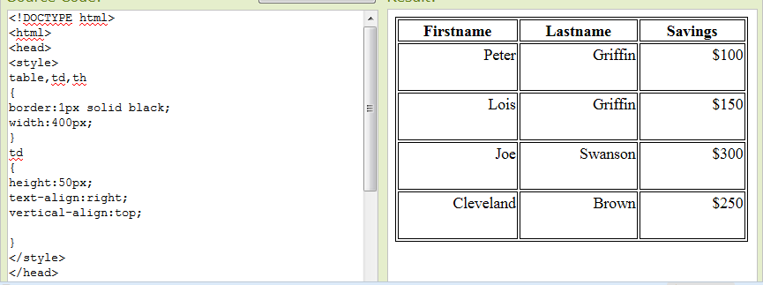
Table Text Alignment
The text in a table is aligned with the
text-align and
vertical-align properties.

Slide 10
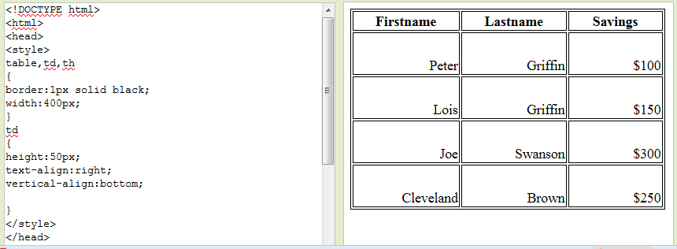
Table Text Alignment
The text in a table is aligned with the
text-align and
vertical-align properties.

Slide 11
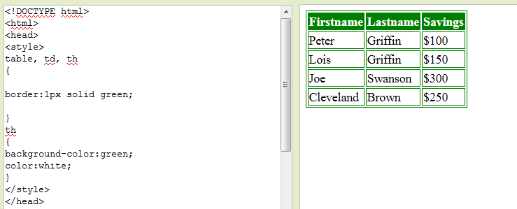
Table Color
The example below specifies the color of the borders, and the text and background color of th elements:

Slide 12
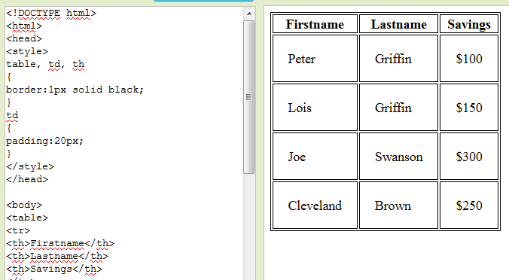
Table Padding
To control the space between the border and content in a table, we use the padding property on td and th elements:

Slide 13
CSS Display-Block and Inline Elements
A block element is an element that takes up the full width available, and has a line break before and after it.
Examples of block elements:
<h1>
<p>
<div>
An inline element only takes up as much width as necessary, and does not force line breaks.
Examples of inline elements:
<span>
<a>

Slide 14
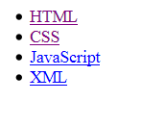

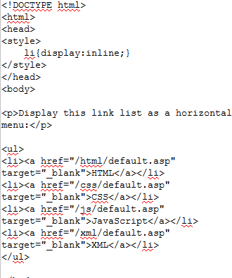
Changing an inline element to a block element, or vice versa, can be useful for making the page look a specific way, and still follow web standards.

Slide 15
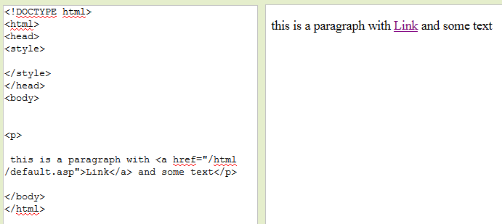
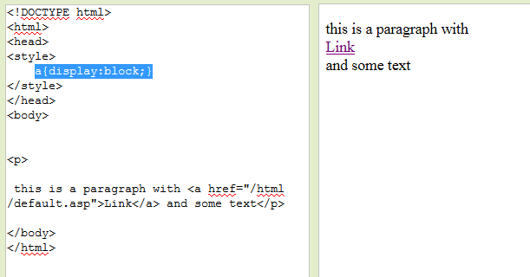

Slide 16
CSS Positioning
The CSS positioning properties allow you to position an element.
Elements can be positioned using the top, bottom, left, and right properties. However, these properties will not work unless the position property is set first. They also work differently depending on the positioning method.

Slide 17
There are four different positioning methods.
Static Positioning
HTML elements are positioned static by default. A static positioned element is always positioned according to the normal flow of the page.
Static positioned elements are not affected by the top, bottom, left, and right properties.
Fixed Positioning
An element with fixed position is positioned relative to the browser window.
Relative Positioning
A relative positioned element is positioned relative to its normal position.
Absolute Positioning
An absolute position element is positioned relative to the first parent element that has a position other than static. If no such element is found, the containing block is <html>
Example

Slide 18
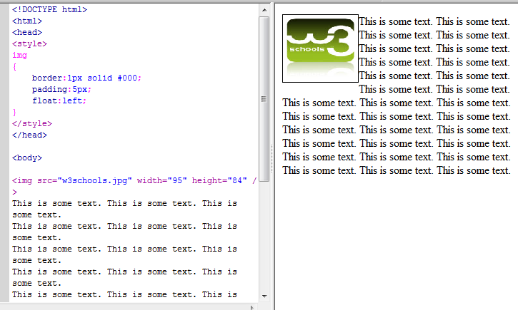
CSS Float
With CSS float, an element can be pushed to the left or right, allowing other elements to wrap around it.
Float is very often used for images, but it is also useful when working with layouts.

Slide 19
Page Building

Slide 20
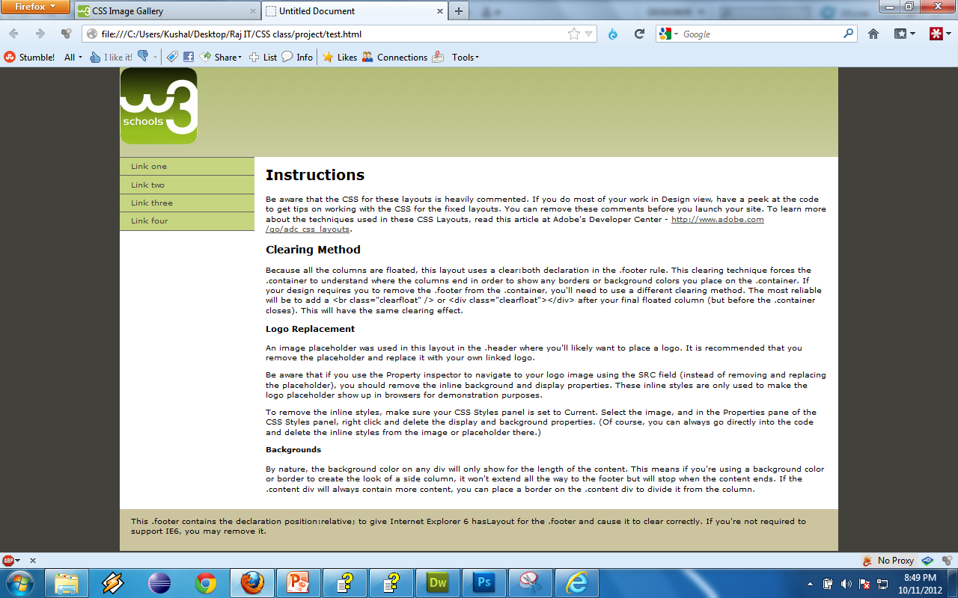

Slide 21

Browser Window
Container (960px)
Header(960 px)
Sidebar
(180px)
Content (780px)
Nav
footer

Slide 22
The End

